Slide 1
Chapter 1: Image processing and computer vision Introduction
by Prof. K.H. Wong,
Computer Science and Engineering Dept. CUHK
khwong@cse.cuhk.edu.hk

Slide 2
Content
1) Introduction
2) Camera model
3) edges detection
4) Feature extraction
5) Hough transform for line circle and shape detection
6) Histogram for color equalization
7) Meanshift for motion tracking
8) Stereo vision
9) Pose estimation and Structure From Motion SFM for virtual reality applications
10) Bundle adjustment for SFM

Slide 3
Image processing
and applications

Slide 4
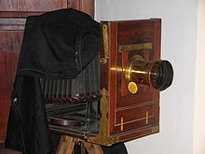
Introduction
Cameras
Images
Raw
Jpeg
Sensors
CMOS
CCD
Column (c)
Row (r)
Pixel value I(c,r) or I(x,y)=(0->255)

Slide 5
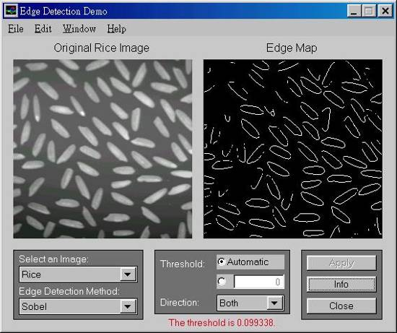
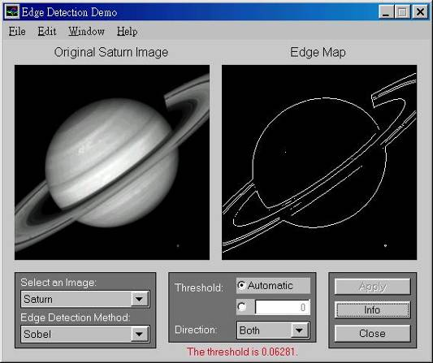
2) Edge detection
Features have many applications: recognition, tracking etc.
The most common are
Point edges
Shape intensity change positions
Boundary edges
Shape intensity changing lines

Slide 6
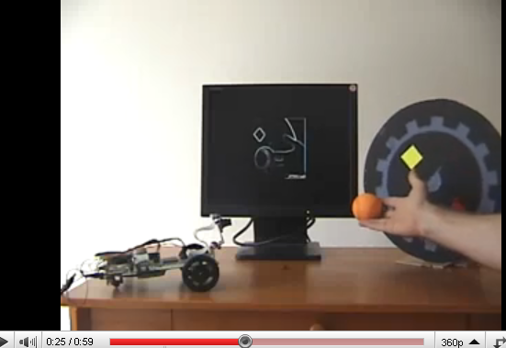
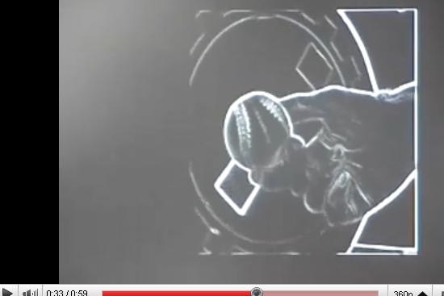
Sobel Demo
http://www.youtube.com/watch?v=z_a6e30aOXo

Slide 7
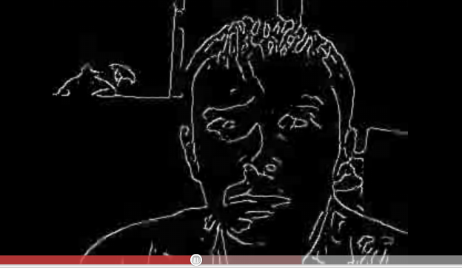
Face edges
Demo
http://www.youtube.com/watch?v=CDlLe-53a0w

Slide 8
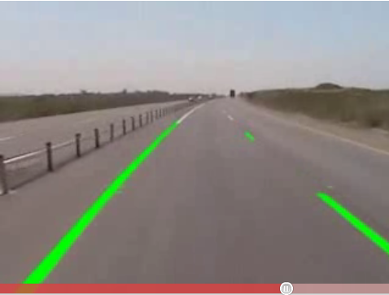
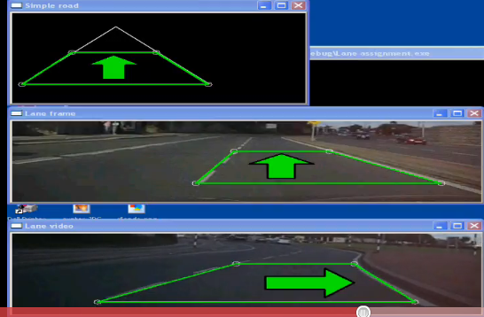
Application of edges
Lane detection
http://www.youtube.com/watch?v=Al4DnNkZUeA&feature=related
http://www.youtube.com/watch?v=9F3_6xL8hEY&feature=related

Slide 9
3) Shape detection (Hough Transform)
Lines
Circles
Irregular shapes

Slide 10
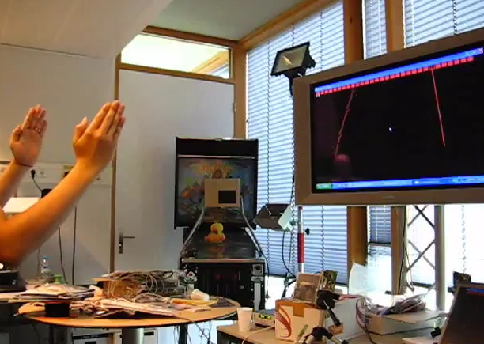
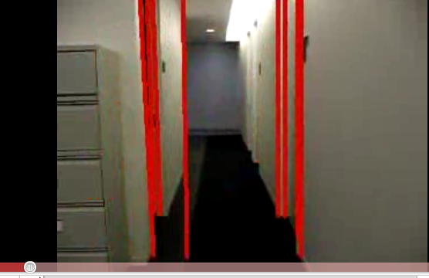
Rectangular object detection in video
Demos using the Hough Transform
https://www.youtube.com/watch?v=6afjN1ranTw
http://www.youtube.com/watch?v=jPEfoi9g0Lw&feature=related

Slide 11
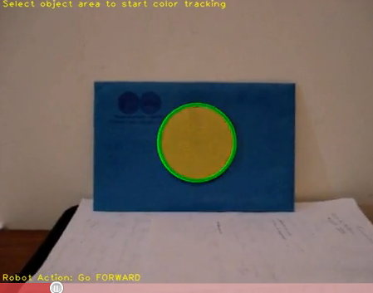
Hough circle detection
Using the opencv library
http://www.youtube.com/watch?v=jVQL1DODyUE

Slide 12
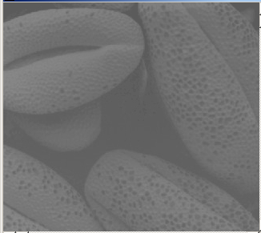
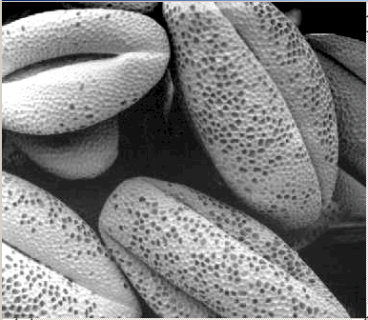
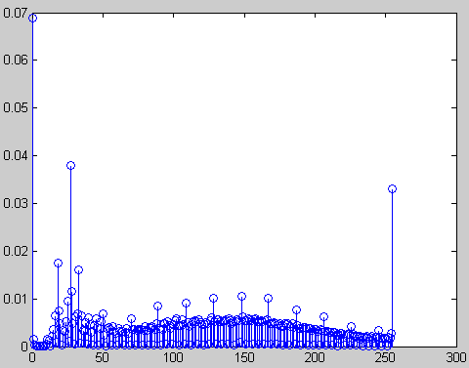
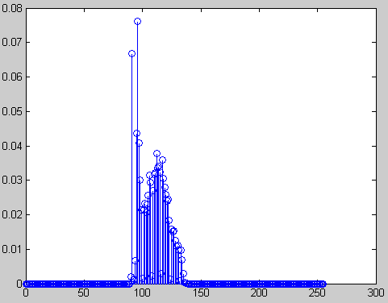
4) Histogram equalization
Input: The picture is poorly shot. Most pixel gray levels are located in a small range.
Output: Use histogram transform to map the marks in ‘r’ domain to ‘S’ domain , so in ‘S’ domain, each S gray level has similar number of pixels.
Input: Low contrast image
r domain
Output: High contrast image
S domain
12

Slide 13
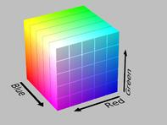

4) (continue) Color models
Cartesian-coordinate representation
RGB (Red , Green , Blue)
cylindrical-coordinate representation
HSV (Hue, saturation, value)
HSL (Hue, saturation, Light)
RGB
HSV
http://en.wikipedia.org/wiki/HSL_and_HSV#From_HSV
13

Slide 14
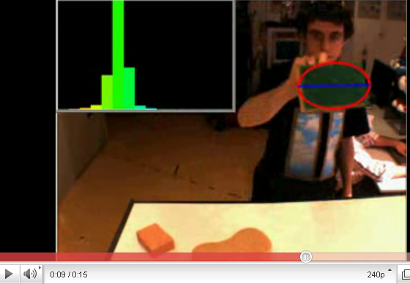
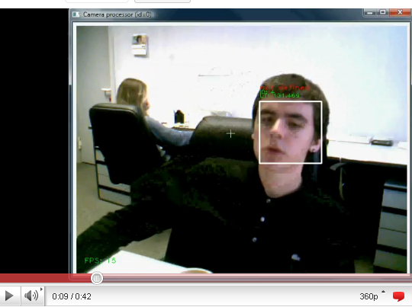
5) Mean shift (cam-shift)
http://www.youtube.com/watch?v=iBOlbs8i7Og
http://www.youtube.com/watch?v=zjteYlhjm-s&feature=related

Slide 15
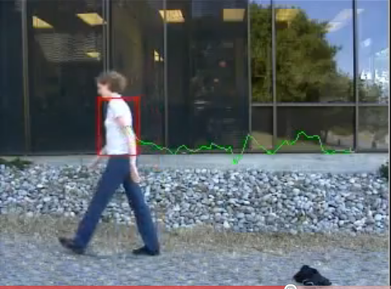
Mean shift application
Track human movement
http://www.youtube.com/watch?v=I53-SZ1o_c0&feature=related

Slide 16
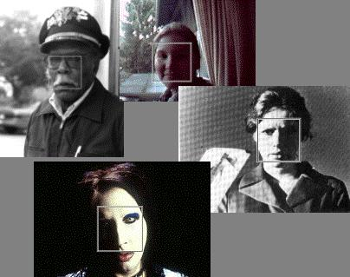
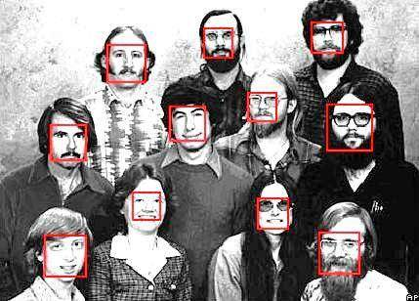
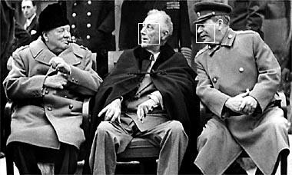
6) Face detection (optional)
From Viola-Jones, IJCV 2005
Notes:
16

Slide 17
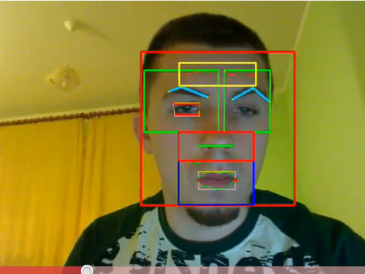
Face detection and tracking
Face tracking
http://www.youtube.com/watch?v=V7UdYzCMKvw&feature=related

Slide 18
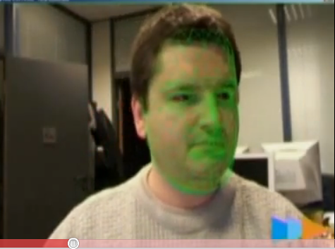
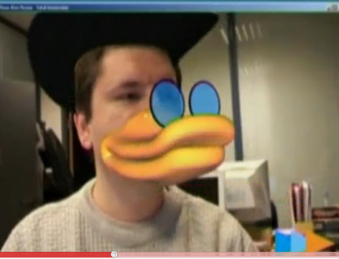
Face tracking applications
Face change
http://www.youtube.com/watch?v=i_bZNVmhJ2o

Slide 19
Topics in 3D computer vision
by Prof. K.H. Wong,
Computer Science and Engineering Dept. CUHK
khwong@cse.cuhk.edu.hk

Slide 20
Motivation
Study the 3D vision problems
Study how to obtain 3D information from 2D images
Study various applications

Slide 21
Applications
3D models from images
Game development
Robot navigation
3G Mobil phone applications,
Location systems
User input

Slide 22
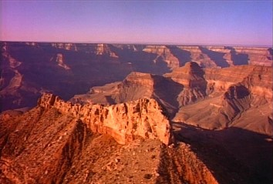
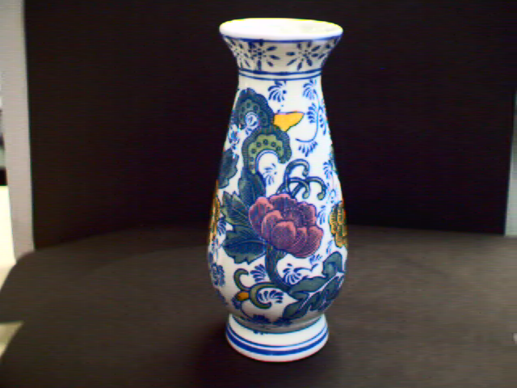
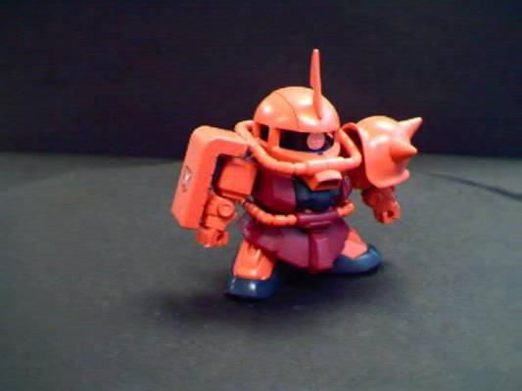
Demo1: 3D reconstruction (see also http://www.cse.cuhk.edu.hk/khwong/demo/index.html) (Click picture to see movie)
Grand Canyon Demo
Flask
Robot
http://www.youtube.com/watch?v=2KLFRILlOjc
http://www.youtube.com/watch?v=xgCnV--wf2k
http://www.youtube.com/watch?v=ONx4cyYYyrI
http://www.youtube.com/watch?v=4h1pN2DIs6g

Slide 23
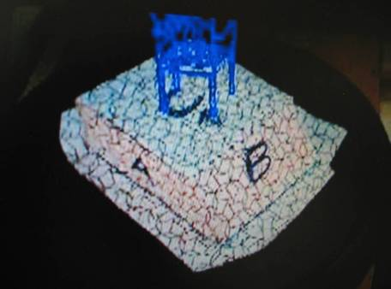
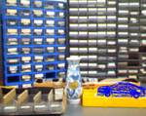
Demo2: augmented reality (Click picture to see movie)
Augmented reality demo
http://www.youtube.com/watch?v=gnnQ_OEtj-Y
http://www.youtube.com/watch?v=zPbgw-ydB9Y

Slide 24
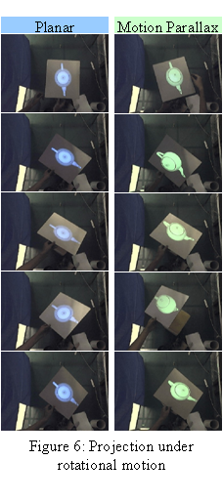
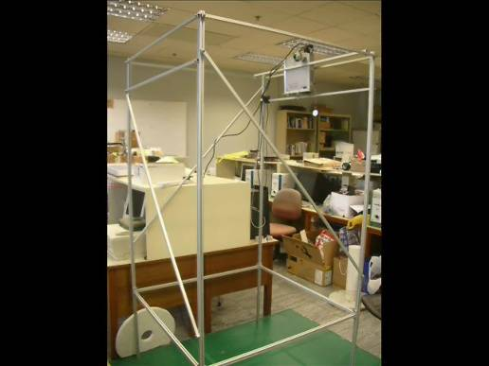
Demo3 Projector camera system (PROCAM) Click pictures to see movies
CVPR 09
A Projector-based Movable
Hand-held Display System
VRCAI09:A Hand-held 3D Display
System that facilities direct
manipulation of 3D virtual
objects
http://www.youtube.com/watch?v=YHhQSglmuqY&feature=channel_page
http://www.youtube.com/watch?v=vVW9QXuKfoQ

Slide 25
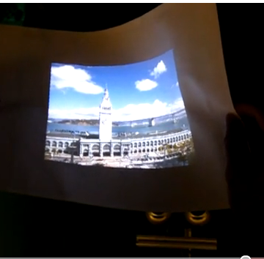
Demo 4
Flexible projected surface
http://www.youtube.com/watch?v=isqg8O9a4LE

Slide 26
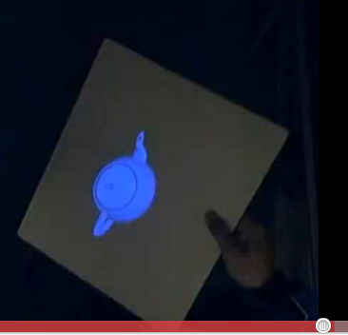
Demo 5
3-D display without the use of spectacles.
http://www.youtube.com/watch?v=oyxR_RT4NNc

Slide 27
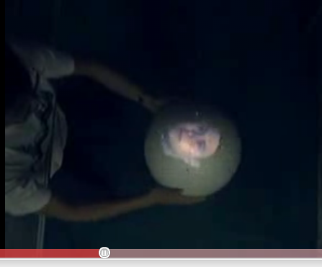
Demo 6
Spherical projected surface for 3D viewing without spectacles.
http://www.youtube.com/watch?v=yVDFcZZ8gDo

Slide 28
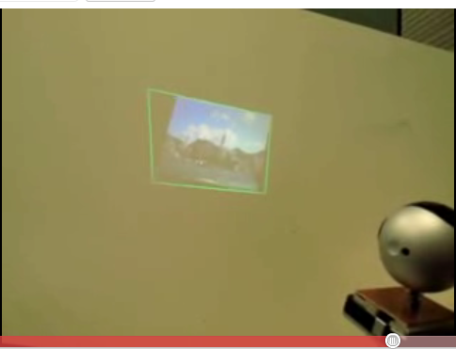
Demo 7
A KEYSTONE-FREE HAND-HELD MOBILE PROJECTION
http://www.youtube.com/watch?v=mbl-BpTnbeA

Slide 29
A quick tour of 3D computer vision
Image capturing
Feature extraction
Model reconstruction or pose estimation
Application of model and pose obtained

Slide 30
Camera structure
Object
CCD
1024x768
Focal length= f
Y
y
f
Z

Slide 31

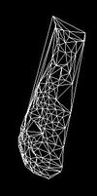
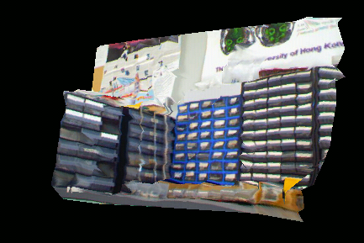
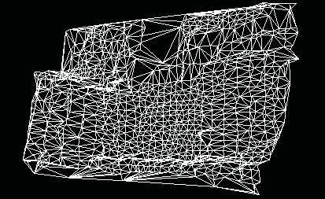
Application 1: Model reconstruction see http://www.cs.cuhk.hk/~khwong/khwong.html
From a sequence of images
Of an object
3D Model
found

Slide 32
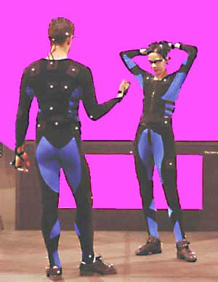
Application 2: Motion tracking
X2
X3
Camera
X1
Body pose
and motion tracking
--By tracking
Images of
white dots and
compute the
3D motion
www.cybercollege.com/tvp026-2.htm

Slide 33
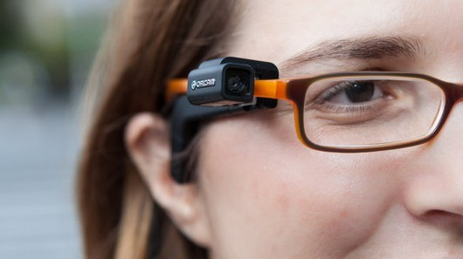
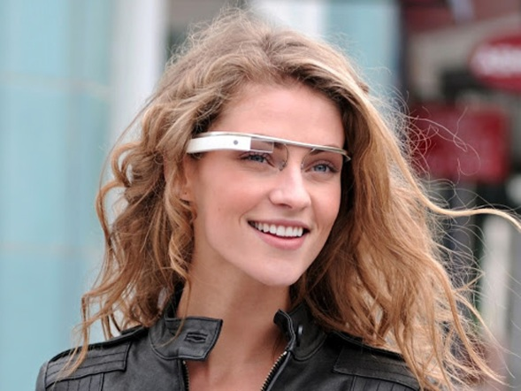
New computer vision products
Orcam
(http://www.orcam.com/)
Demos: https://www.youtube.com/watch?v=24yIl8tPvfU
https://www.youtube.com/watch?v=j8lScHO2mM0
Google glass
(http://www.google.com/glass/start/)
Demo:
https://www.youtube.com/watch?v=j8lScHO2mM0

Slide 34


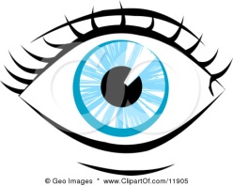
CU-GLASS at CUHK
Glass frame(no lens)
Be able to overlay images or text to our normal view
Simple, low cost and easy to build
Can duplicate for the 2nd eye
Close up
Lens
See through glass
CCD display
For text or graphics
The CU-GLASSES

Slide 35
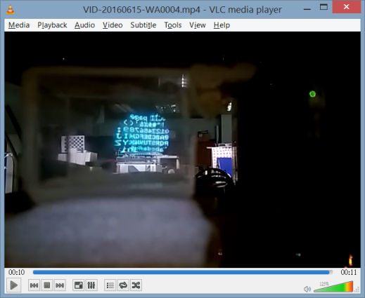
The idea
Top down view
Eye
Reflective , see through glass
CCD
display
Close up
Lens

Slide 36
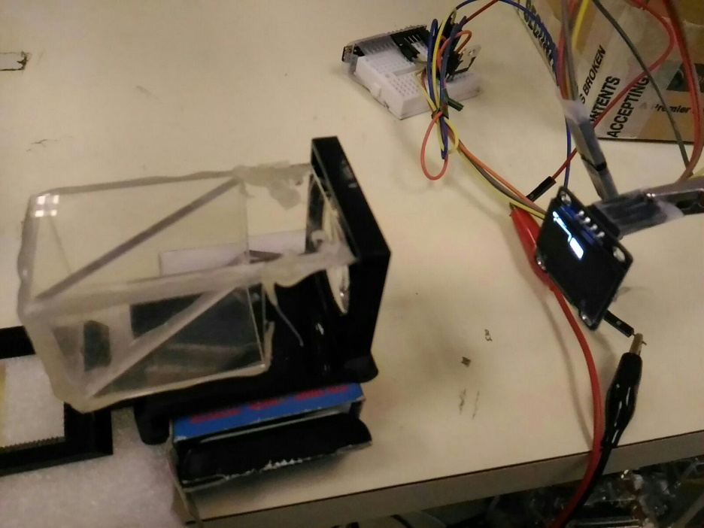

Tests
Video link
https://youtu.be/i2lpo0DHaWA

Slide 37
Computer vision (3D)
The mathematics

Slide 38
3D vision processing
Projection geometry: Perspective Geometry
Edge detection
stereo correspondence

Slide 39
Basic Perspective Geometry
Old position
Model M at t=1
image
P=(x,y,z)
v-axis
Y-axis
P’=(x’,y’,z’)
Z-axis
New position
(α)
(β)
c (Image center)
Ow (World center)
u-axis
(γ)
f=focal length
X-axis

Slide 40
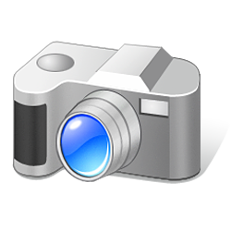
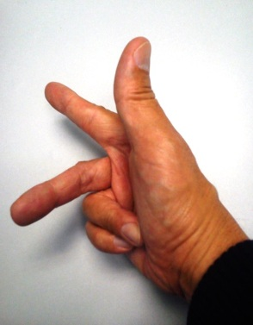
Motion of camera from world to camera coordinates
Camera motion (rotation=R_{c}, translation=T_{c}) will cause change of pixel position (x,y), See p156[1]
Y_{c}
Camera center
Rc,Tc
X_{c}
Y_{w}
Z_{w}
Z_{c}
an_y
an_z
X_{w}
World center
Cameras v.3d
an_x

Slide 41
3D to 2D projection
Perspective model
u=F*X/z
v=F*Y/z
Virtual
Screen
or CCD
sensor
World
center
Y
v
v
F
Z
F
Real
Screen
Or
CCD
sensor
Thin lens
or a pin hole

Slide 42
Summary
Image processing and computer vision are useful in many applications
Becoming more and more popular since every one is carrying cameras in their mobile devices.
We will study the mathematics and algorithms of image processing and vision programming

